Slide 1
tSQLt Database Unit Testing

Slide 2
tSQLt Database Unit Testing
Dexter Baga
dexter.baga@gmail.com
LinkedIn : dexterbaga
Twitter : @DexterBaga
Hunter Industries Inc.
hunterindustries.com
Mob Programming
mobprogramming.org

Slide 3

https://github.com/DexterBaga
tSQLt-Database-Testing

Slide 4
State Of Testing
🔨
Code
Database
?
BDD
UNIT TESTS

Slide 5
How do we get there?
Database Unit Testing

Slide 6
Unit Test
A test written by a programmer for the purpose of ensuring that the production code does what the programmer expects it to do.
- Uncle Bob
http://blog.cleancoder.com/uncle-bob/2017/05/05/TestDefinitions.html

Slide 7
.
What Can We Use ?
tSQLt
Unit Testing Framework
For MS SQL Databases
tsqlt.org

Slide 8
.
How Do I Get Started?
Download File
Unzip File
Execute scripts
http://tsqlt.org/user-guide/quick-start/

Slide 9
.
What Can We Test ?
Stored Procedures
Functions
Views
Tables

Slide 10
.
What does a test look like ?
Unit Tests are Stored Procedures containing your SQL test script

Slide 11
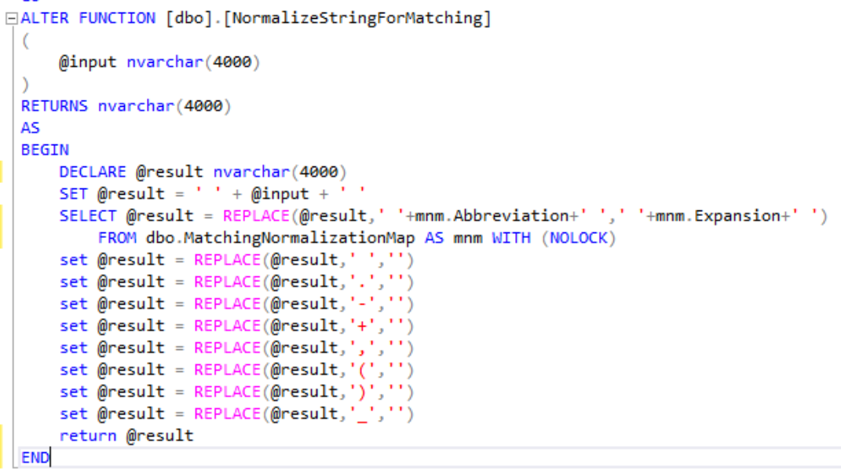
.
Unit Under Test

Slide 12
.
Unit Test
ALTER procedure [UnitTests].[test NormalizeStringForMatching should remove non alphanumeric characters]
as
Begin
-- ARRANGE --
declare @testString as varchar(100) = 'We are &* -)+ !@# ~\$ ><? __ #,`}{characters’;
declare @expectedResult as varchar(100) = 'Wearecharacters’;
declare @actual as varchar(100);
-- ACT --
select @actual = dbo.NormalizeStringForMatching(@testString);
-- ASSERT --
exec tSQLt.assertequals @expectedResult, @actual
end

Slide 13
.
Yes We Can…
Organize Tests
… Create test classes
contactdata
redemption
orders

Slide 14
.
Yes We Can…
Use Assertions
AssertEquals
AssertEqualsTable
AssertEmptyTable
…and more

Slide 15
.
Yes We Can…
Mock Objects
Tables
Views

Slide 16
.
Yes We Can…
Spy Procedures
Execution count
Parameter values
Set return value

Slide 17
.
Yes We Can…
Fake Functions
Return hard coded value
Evaluate parameters

Slide 18
.
Yes We Can…
CI/CD
Sample : http://tsqlt.org/177/integrating-tsqlt-with-cruise-control/

Slide 19
Lets Try It

